Slide 1
Explainable AI and Semantic Web
Md Kamruzzaman Sarker
Data Semantics Lab
Wright State University

Slide 2
Outline
Motivation
What is explainable AI
State of the art in different AI fields
Limitation
Scope of using Semantic web technologies

Slide 3
Our Machine Learning Model
https://imgs.xkcd.com/comics/machine_learning_2x.png

Slide 4

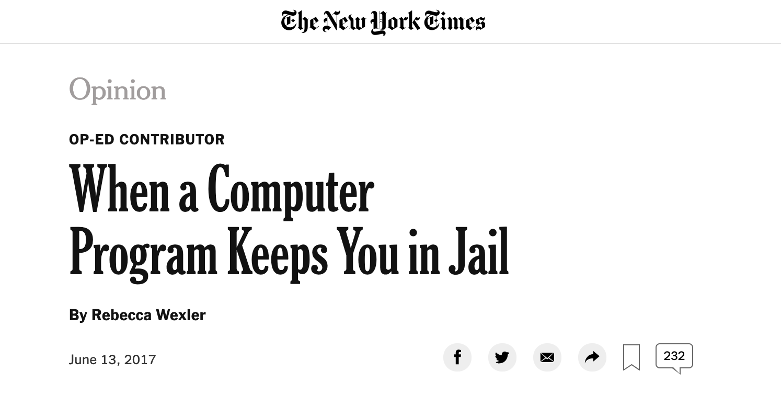
Consequences
https://www.theverge.com/2018/3/21/17144260/healthcare-medicaid-algorithm-arkansas-cerebral-palsy
Artificial Intelligence is being used in Health Care, Judiciary Systems and has great impact on our life.
http://nytimes.com/2017/06/13/opinion/how-computers-are-harming-criminal-justice.html

Slide 5
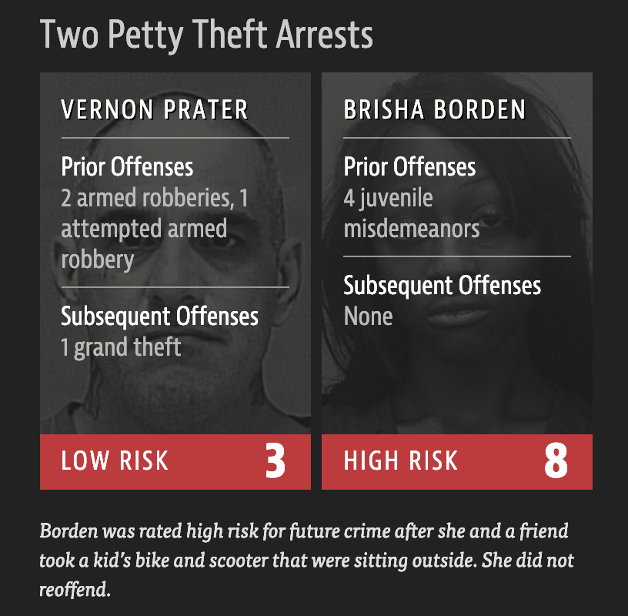
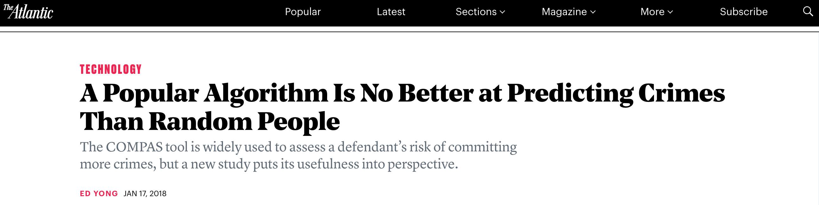
Consequences
https://www.theatlantic.com/technology/archive/2018/01/equivant-compas-algorithm/550646/
The COMPAS tool is widely used to assess a defendant’s risk of committing more crimes.
But a new study puts its usefulness into perspective.

Slide 6
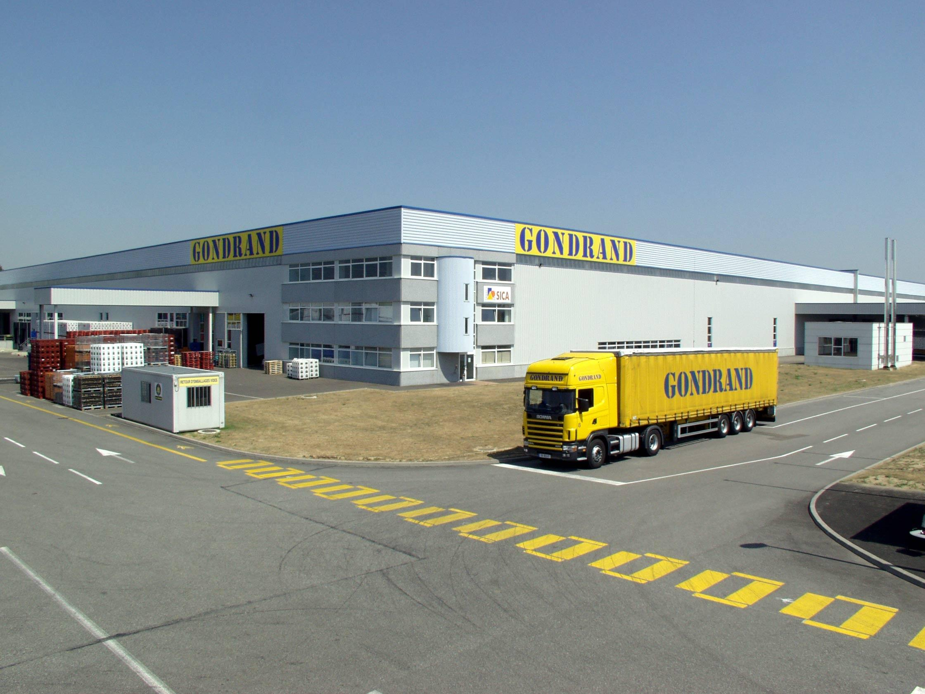
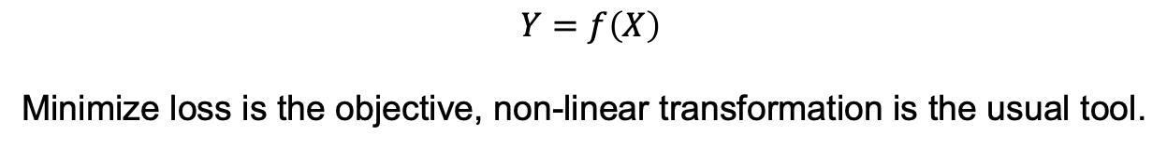

AI Model
$$Y=f\left(X\right)$$
Minimize loss is the objective, non-linear transformation is the usual tool.
AI Model
Warehouse
Why it’s a warehouse?
Why it’s not a market?
How it decided to call it warehouse?
When the transformation becomes too complicated we don’t understand what is going inside.
We call it black box.

Slide 7
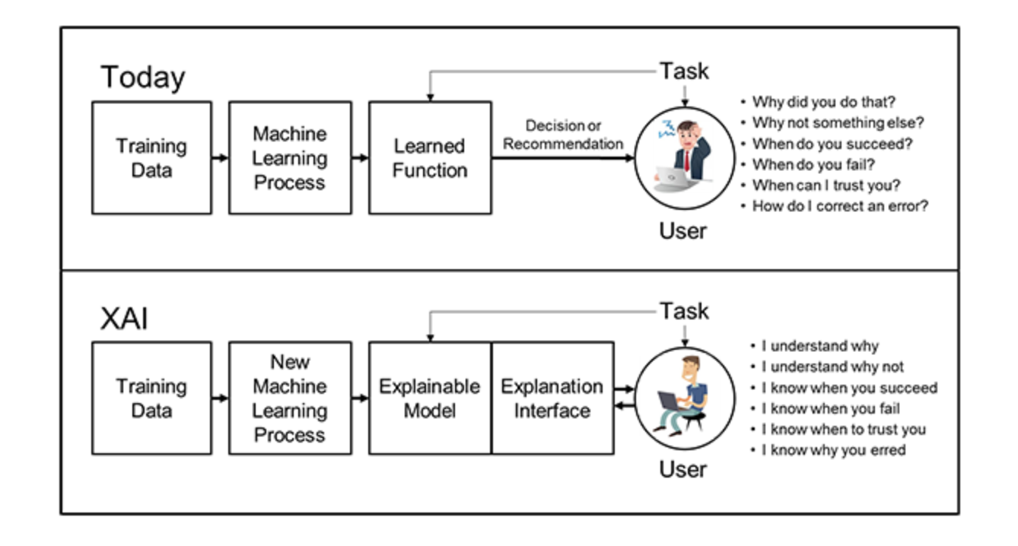
Explainable Artificial Intelligence
We need to understand what is going on.
Explainable AI (XAI) are hoped to help us -
explain the decision
understand the decision and model
debug the decision
Explainable Artificial Intelligence
Mr. David Gunning, 2017, https://www.darpa.mil/program/explainable-artificial-intelligence

Slide 8
Explainable AI
No formal, technical, agreed upon definition!
Explainability is an ill-defined term! [Lipton 2016]
Different level of people need different type of explainability!
Patients expectation and doctors expectation are different from same AI model.
Not limited to machine learning! [Lipton 2016, TomseL et al. 2018, Rudin 2018]

Slide 9
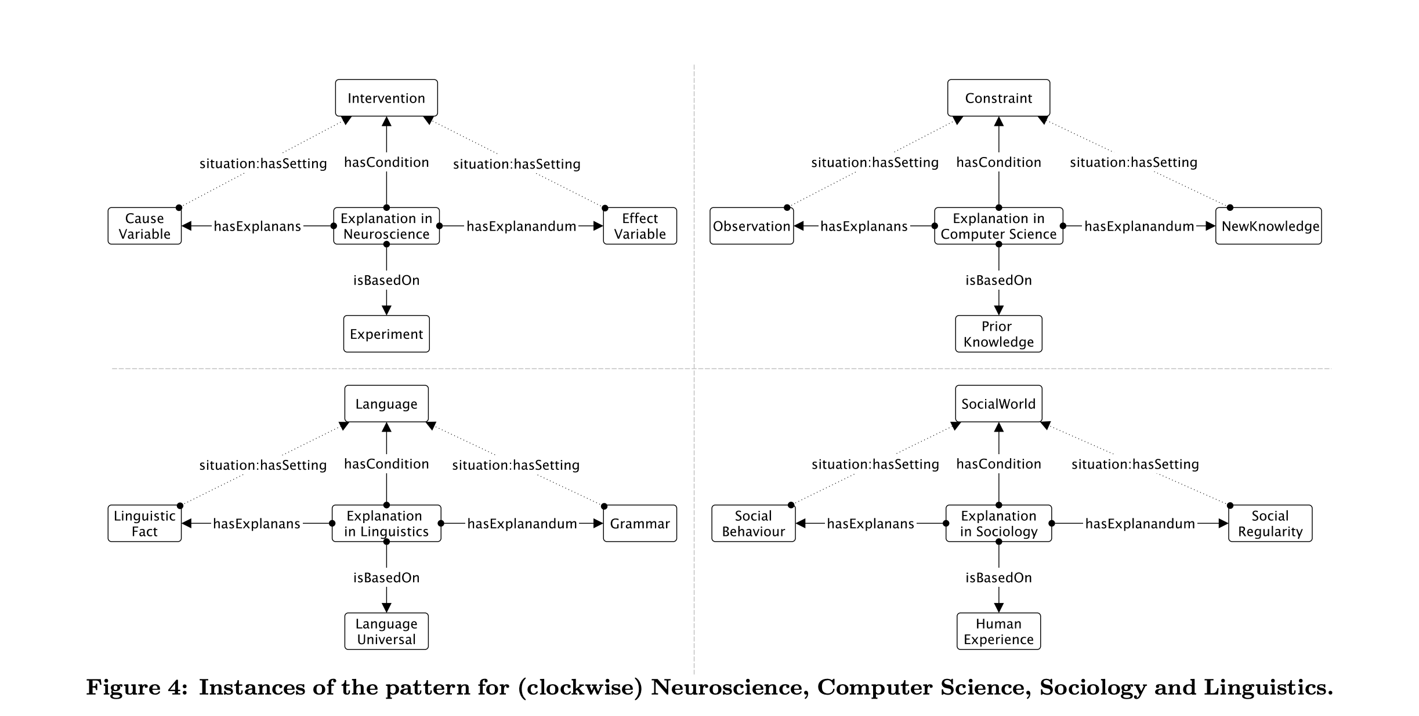
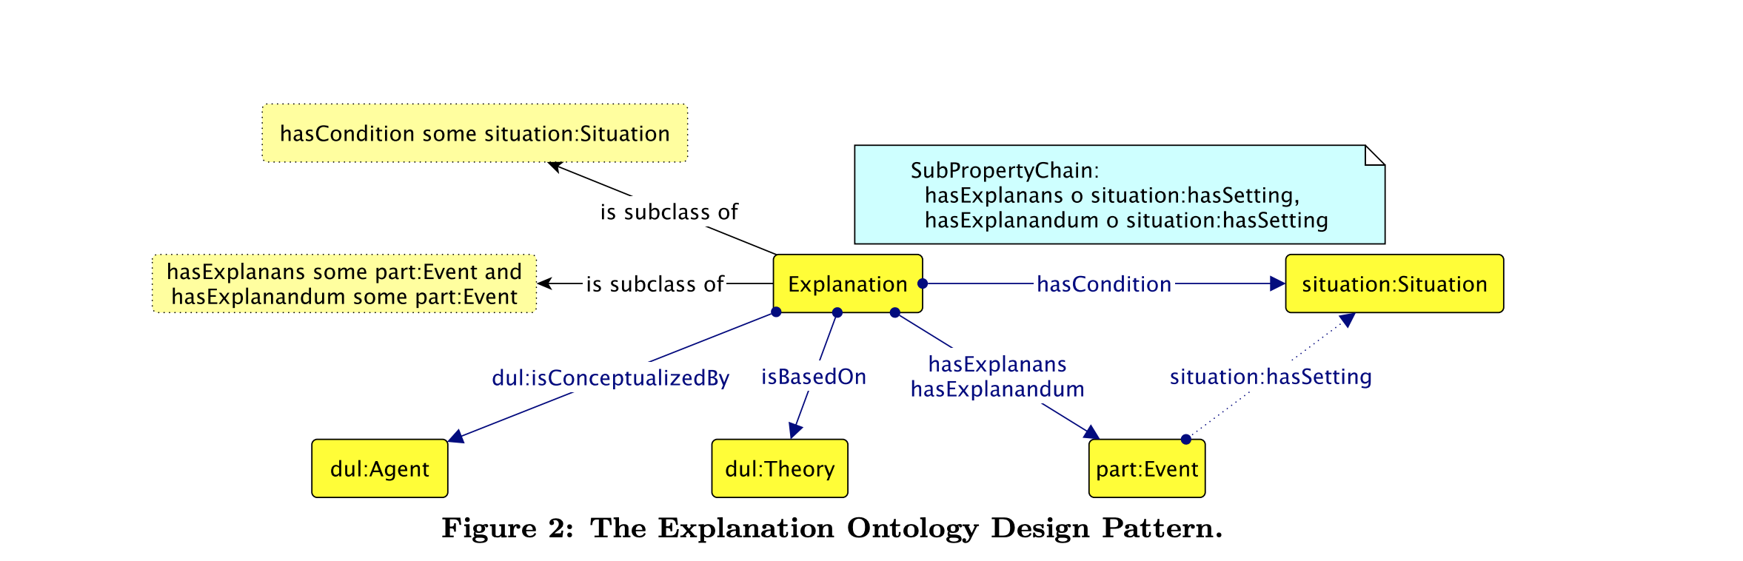
Explainable AI
Ontology Design pattern for explanation
[Ilaria 2015]
Explanation differs by field !!

Slide 10
Our (arguable) definition
Explainable AI is a branch of AI which help to get explanation from the AI model.
Explanation is the ability of the model to satisfy users understandability of the decision and model.

Slide 11
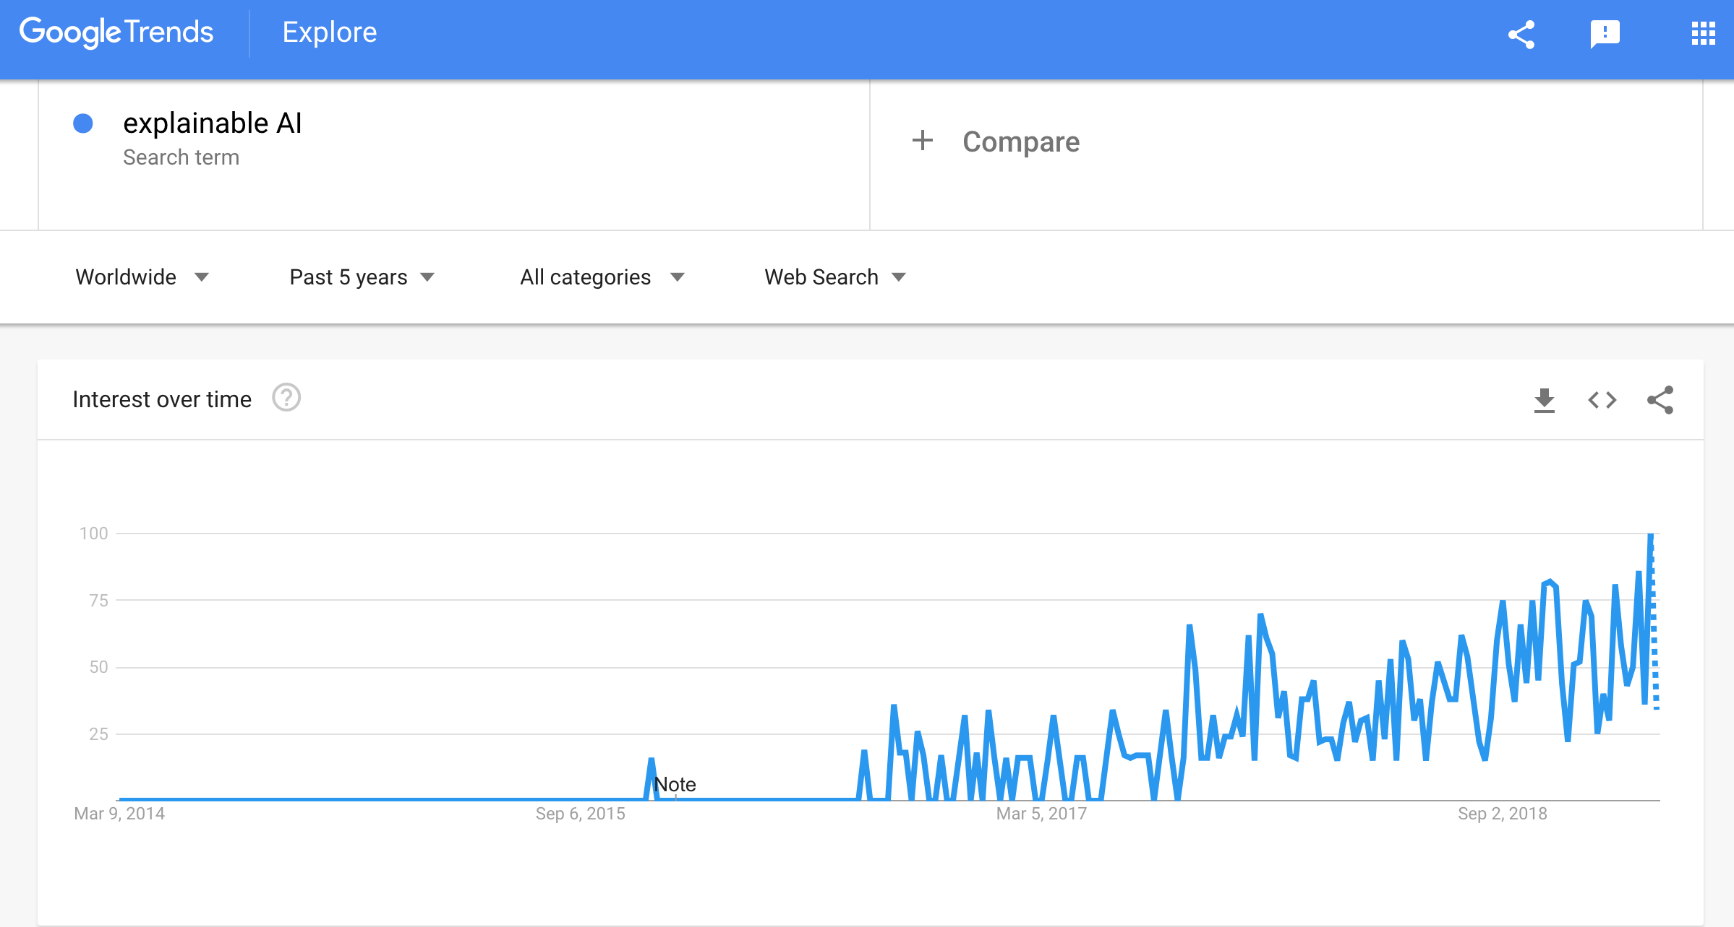

Explainable AI
Moving from the definition we need to explain the AI models.
Trend on google shows large interest for this.
Researchers are also working hard to find ways.
More than 7000 papers related to XAI since 2015.

Slide 12
Options for Explanation
Explanation
Before Building Model
Explanation
During Building Model
Explanation
After Building Model

Slide 13
Before Building Model
Feature Visualization¹
Exploratory data analysis²
Some features may be redundant
Some features may not help the model
Correlation can be used to identify redundant features. [The Elements of Statistical Learning: Data Mining, Inference, and Prediction, Trevor Hastie Robert Tibshirani Jerome Friedman]
[1,2]
[Viégas and Wattenberg ’07]
[Maaten et al. ’08]
[Amershi et al. ’09]
[Patel et al. ’10]
[Varshney et al. ’12]
[Tukey 77]
How much this help for explanation?

Slide 14
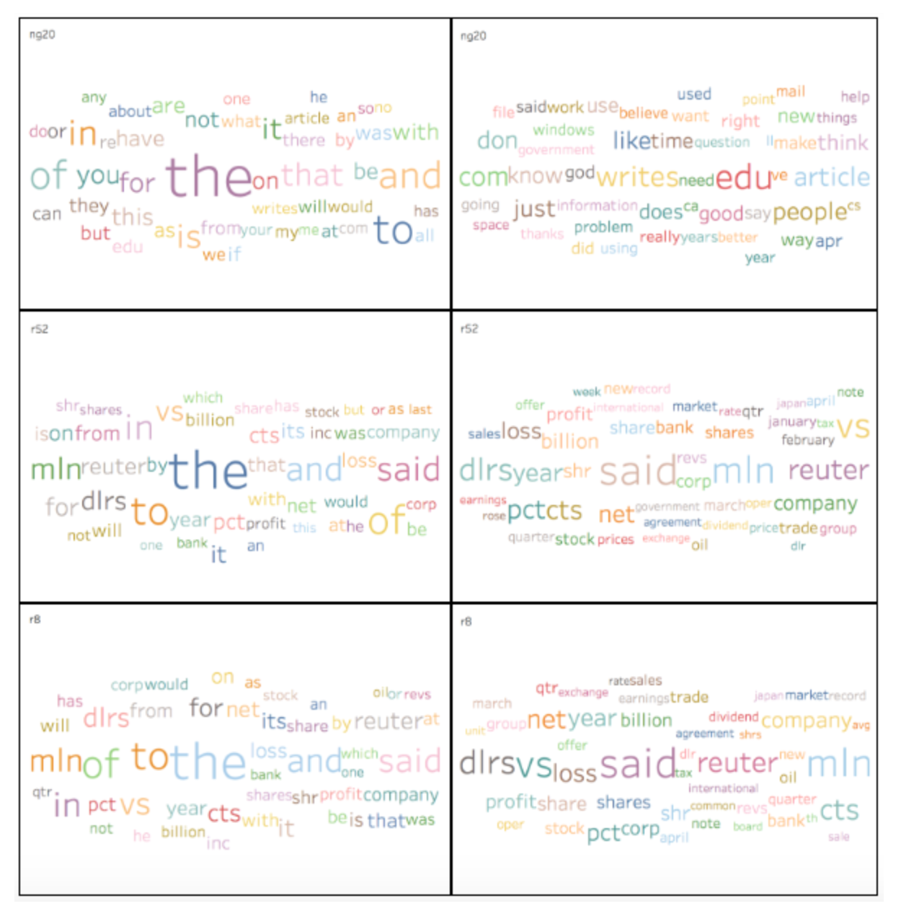
Feature Visualization & Exploratory data analysis
- Word Cloud for 20 news group dataset for different classes.
- Helps to get idea for which class has which type of texts.
How much this help for explanation?
Give some idea about the dataset.
Different classifier work differently, so not giving explanation about the model.
If features are not understandable (numeric) this only helps to get cluster of group, but does not help for human understanding of the classifier decision or model.
http://qwone.com/~jason/20Newsgroups/

Slide 15
Explanation
Before Building Model
Explanation
During Building Model
Explanation
After Building Model
Not satisfying us, let’s go to next step

Slide 16
During Building Model
Choosing interpretable model
Common belief that some models are explainable.
Rule Based model
KNN
Linear Regression
Decision tree
Are they really interpretable?

Slide 17
During Building Model
Choosing interpretable model
Develop rule based model which has theoretical underpinning to the solution.
[Breiman, Friedman, Stone, Olshen 84]
[Rivest 87]
[Muggleton and De Raedt 94]
[Wang and Rudin 15]
Using rule set user can trace how the solution is being made.
For large systems making rule set is not feasible.
Face recognition system with thousand of features!!!!!
For some systems making rule set is not even practical.
Music classifier where input comes as waveform.

Slide 18
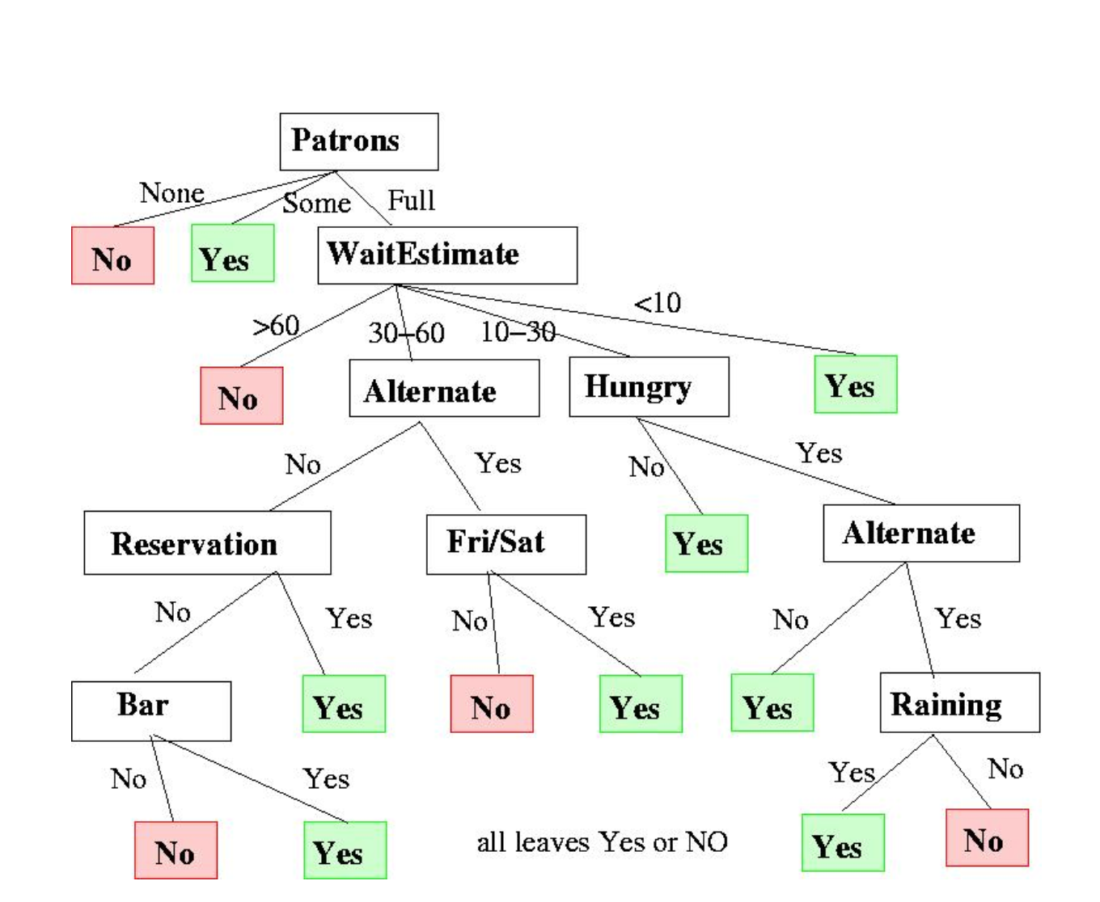
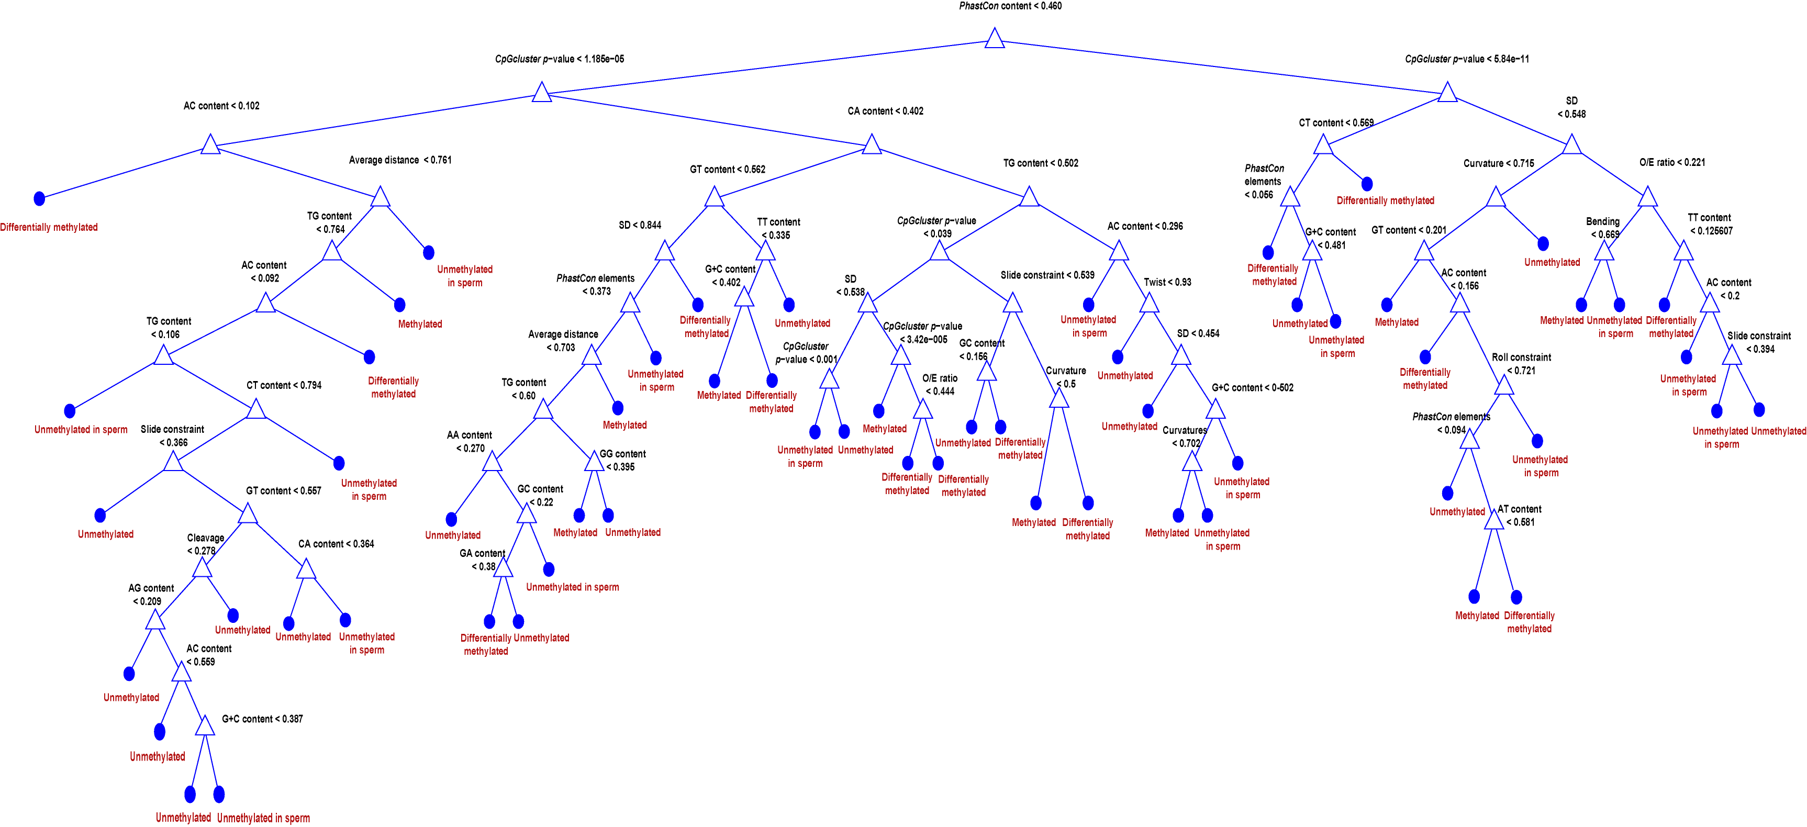
During Building Model
Decision Tree : Example
Problem is to predict the class from four CGI methylation classes.
Hard to understand and even hard to visualize.
Problem to wait or not for a table at a restaurant?
Understandable as features are understandable.
http://www.cs.bham.ac.uk/~mmk/Teaching/AI/l3
[Previti 2009]

Slide 19
During Building Model
Rule Based model
KNN
Linear Regression
Decision tree
Rule based model are not scalable.
Others are interpretable as long as the model is small.

Slide 20
Explanation
Before Building Model
Explanation
During Building Model
Explanation
After Building Model
Not satisfying us, let’s go to next step
Not satisfying us, let’s go to next step

Slide 21
After Building Model
After Building Model
Explain Output
Explain Model
Model agnostic
Model dependent

Slide 22
Explain Output
Large class of AI models
Deep Neural Network
Convolutional Neural Network
LSTM
Recurrent Neural Network
SVM
Some explanation techniques are model dependent and some are not. [Riccardo, 2018]
After Building Model
Explain Output
Explain Model
Model agnostic
Model dependent

Slide 23
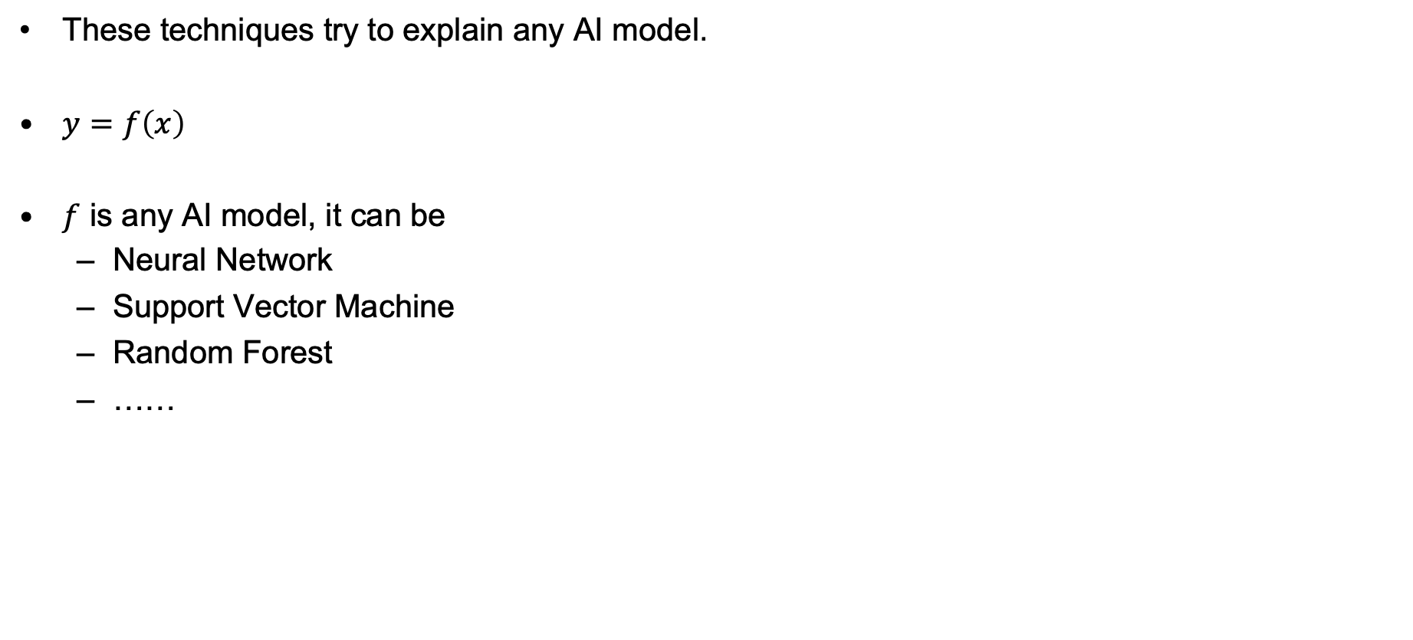
Model Agnostic
These techniques try to explain any AI model.
$y=f\left(x\right)$
$f$ is any AI model, it can be
Neural Network
Support Vector Machine
Random Forest
……
After Building Model
Explain Output
Explain Model
Model agnostic
Model dependent

Slide 24
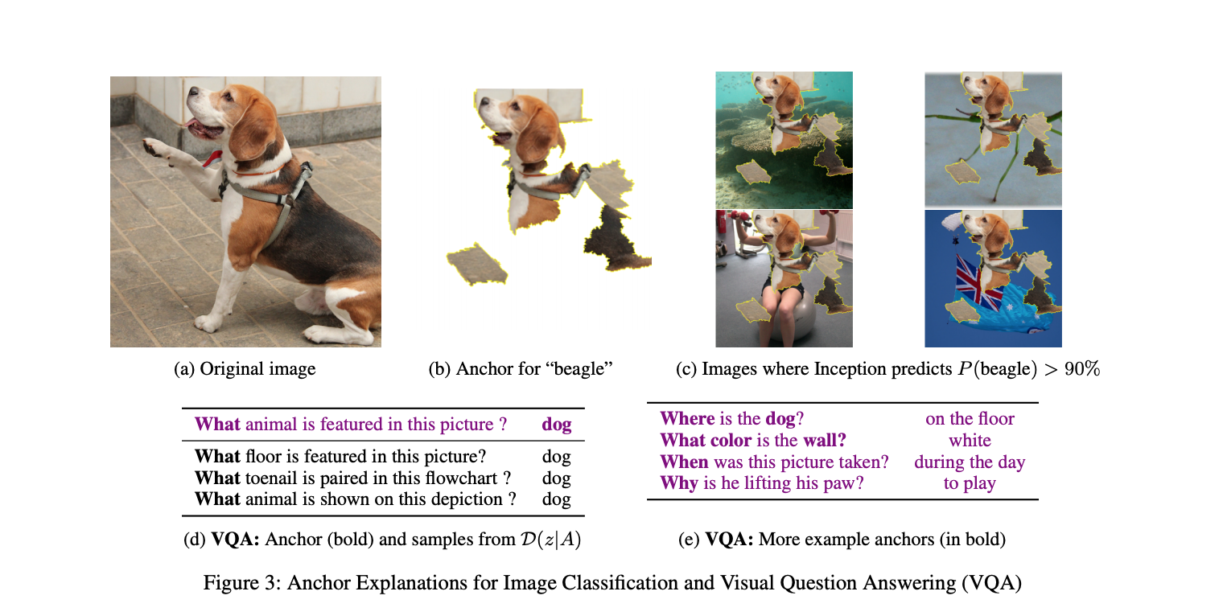
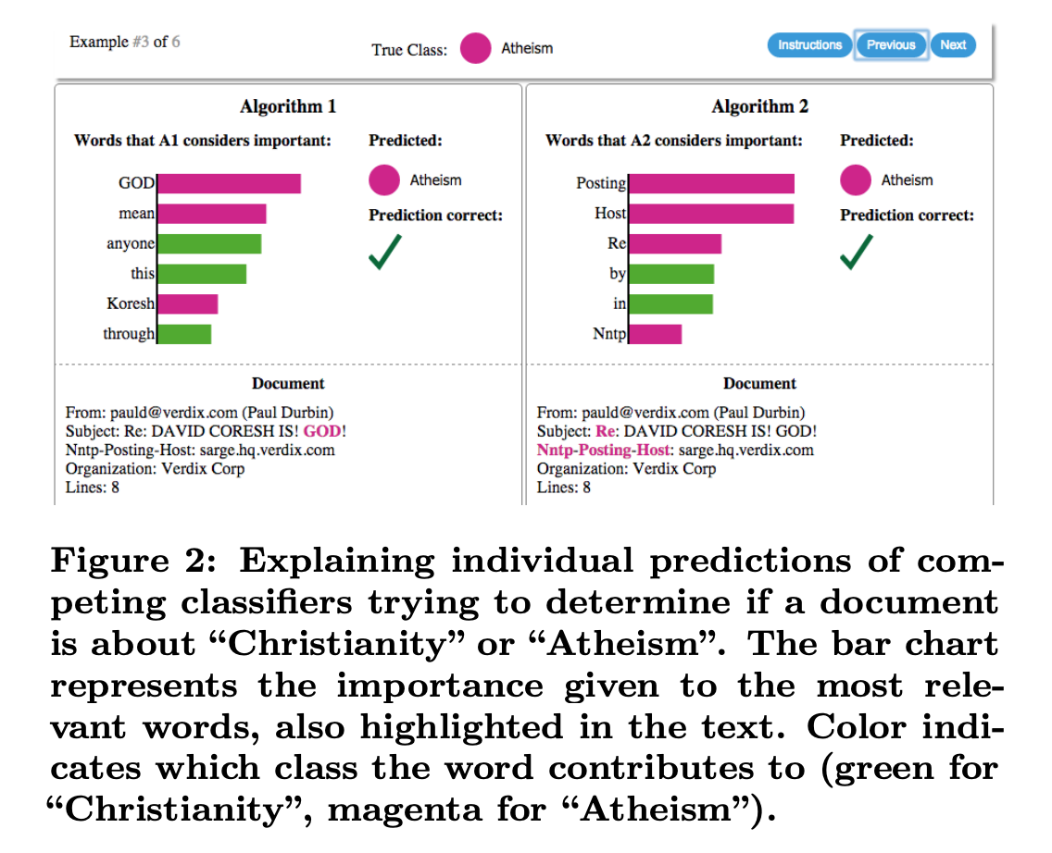
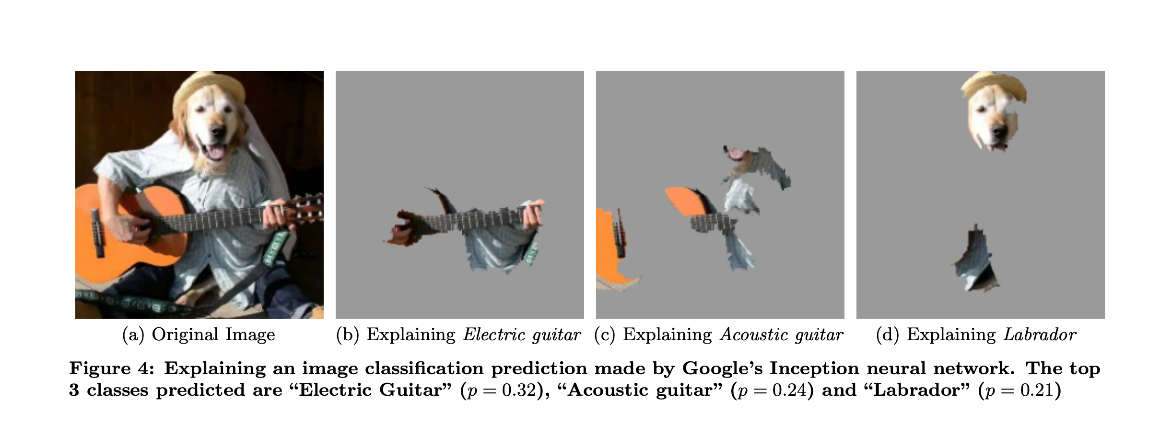
Model Agnostic
LIME : Local Interpretable Model-Agnostic Explanations¹
Anchors: High-Precision Model-Agnostic Explanations²
Explain models by presenting representative individual predictions
Perturb the input data around the prediction locally
¹[Ribeiro 2016], ²[Ribeiro 2018]

Slide 25
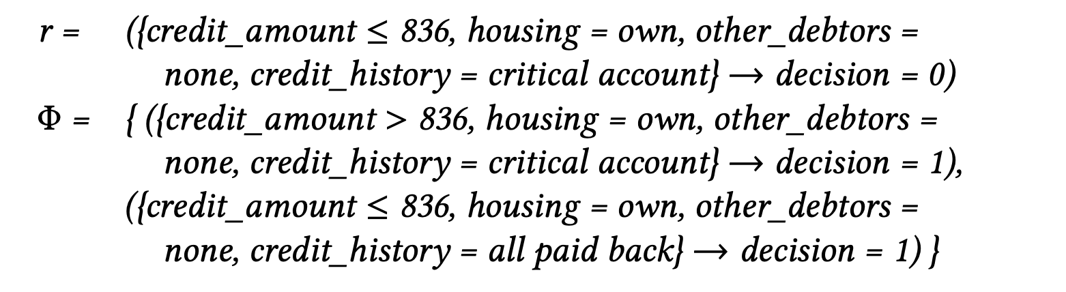
Model Agnostic
LORE : LOcal Rule-based Explanations
Uses a genetic algorithm approach to generate a decision tree as interpretable classifier
Explanation consists in a rule derived from the decision tree classifier.
LORE also returns a set of counterfactual rules, suggesting the changes in the instance’s features of x that may lead to a different outcome.
[Guidotti, 2018]

Slide 26
Model Agnostic
Limitation
Explanation are not stable.
Same model m, same input x can generate different explanation.
Explanation only faithful locally.
If input x come from different distribution explanation are terrible.

Slide 27
After Building Model
Model dependent explanations are mostly for neural networks and it’s variants.
Mainly two approaches are used.
Investigate the hidden layers
Build another model to create explanation
After Building Model
Explain Output
Explain Model
Model agnostic
Model dependent

Slide 28
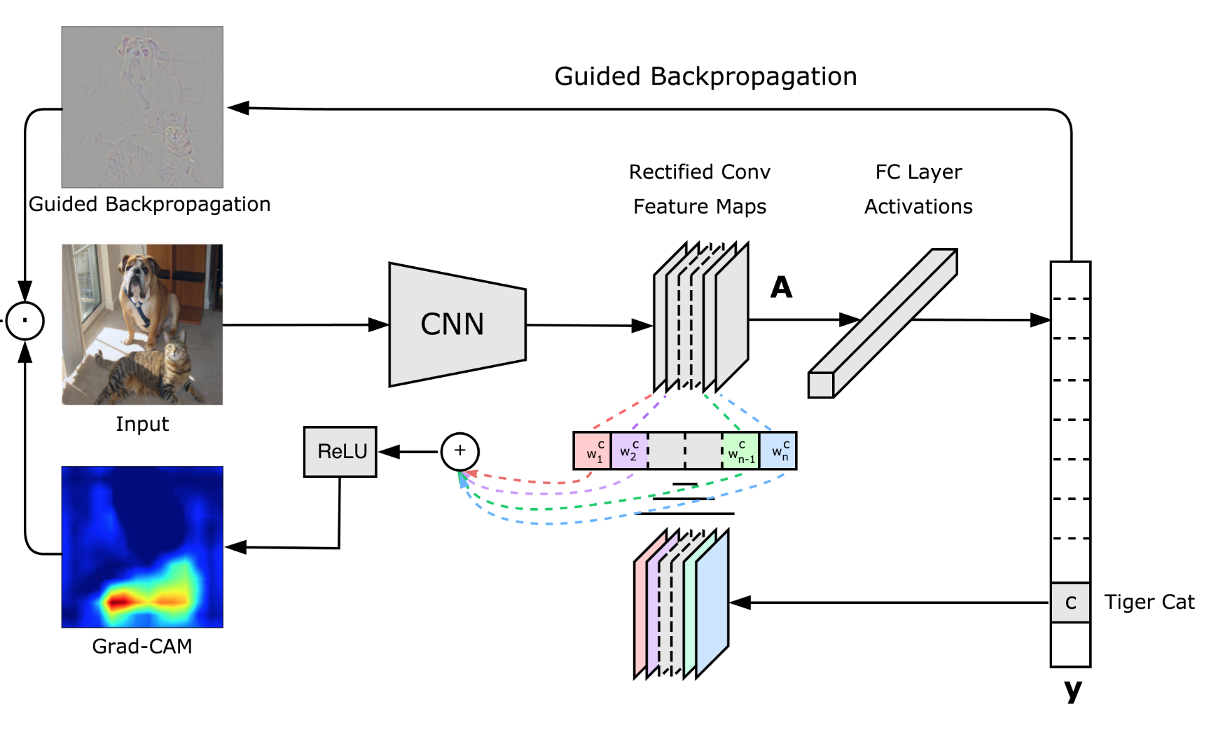
Model Dependent
Investigate the hidden layers
Visualizing the regions of the input that are "important" for predictions.
Common Strategy:
Backpropagate the output/loss/gradient to the input layer.
Compares the activation of each neuron to its 'reference activation’
Show the difference.
Ramprasaath R. Selvaraju, Michael Cogswell, Abhishek Das, Ramakrishna Vedantam, Devi Parikh, Dhruv Batra "Grad-CAM: Visual Explanations from Deep Networks via Gradient-based Localization", https://arxiv.org/abs/1610.02391

Slide 29
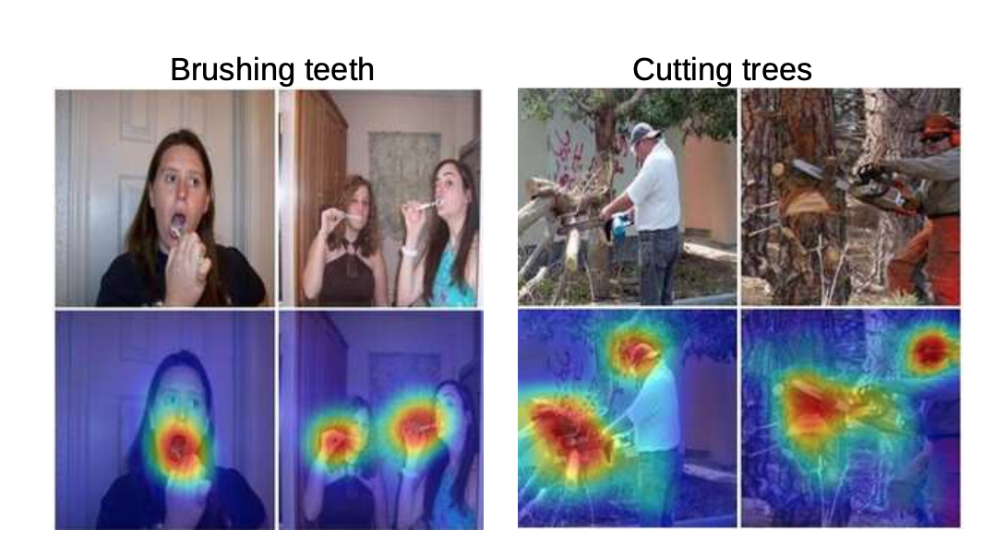
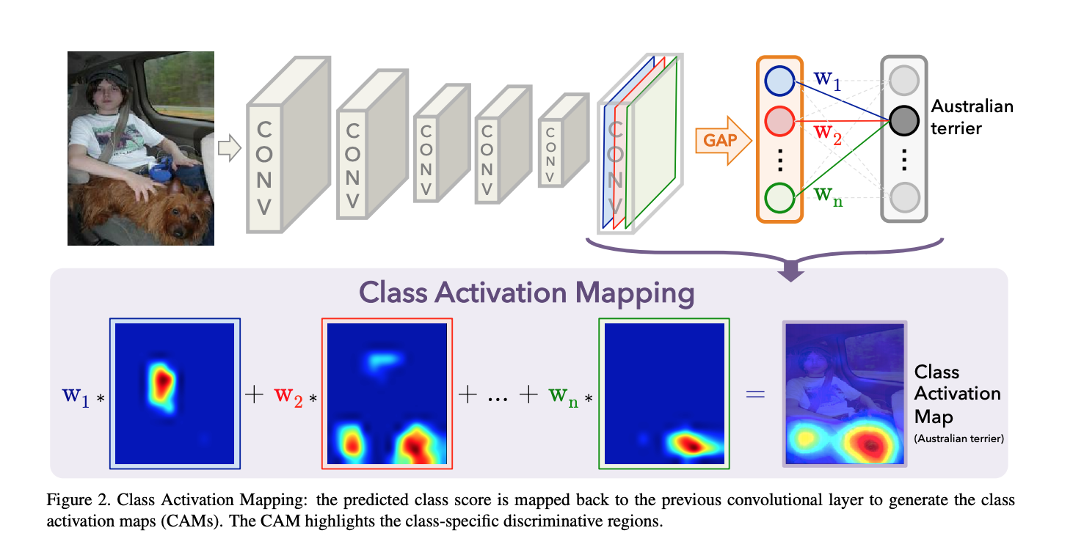
Model Dependent
Investigate the hidden layers
Showing important part of the input which contributes more to the class decision.
Bolei Zhou, Aditya Khosla, Agata Lapedriza, Aude Oliva, Antonio Torralba,
Learning Deep Features for Discriminative Localization, https://arxiv.org/abs/1512.04150

Slide 30
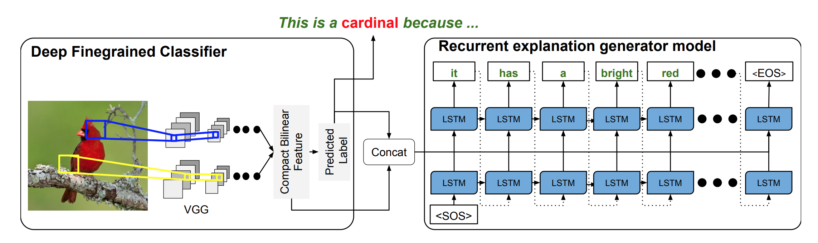
Model Dependent
Build another model to create explanation
Train a black box and then again train another black box to produce explanation!!
Visual explanations [Hendricks et al. ’16]
What will happen if the explanation module produces wrong explanation ??

Slide 31
Model Dependent
Limitation
Some-times explanation are hard to understand.
Single bit change in the input (even if the if input is large) may give different explanation.
Newly created explanation module may give wrong answers.

Slide 32
Model Explanation
Need to understand how the model is producing output.
Is the model generalized enough so it will not be fooled? (Adversarial attack) [Chakraborty, 2018]
Mainly two approaches:
Rule extraction from neural network.
Looking the hidden layers
After Building Model
Explain Output
Explain Model
Model agnostic
Model dependent

Slide 33
Model Explanation
Rule extraction from neural network.
[Sebastian Thrun, 1995 ]
[Tameru Hailesilassie, 2016 ]
[Mark W. Craven, 1996 ]
Create rule/decision tree from trained neural network.
Works for small number of features
and where the features are understandable.

Slide 34
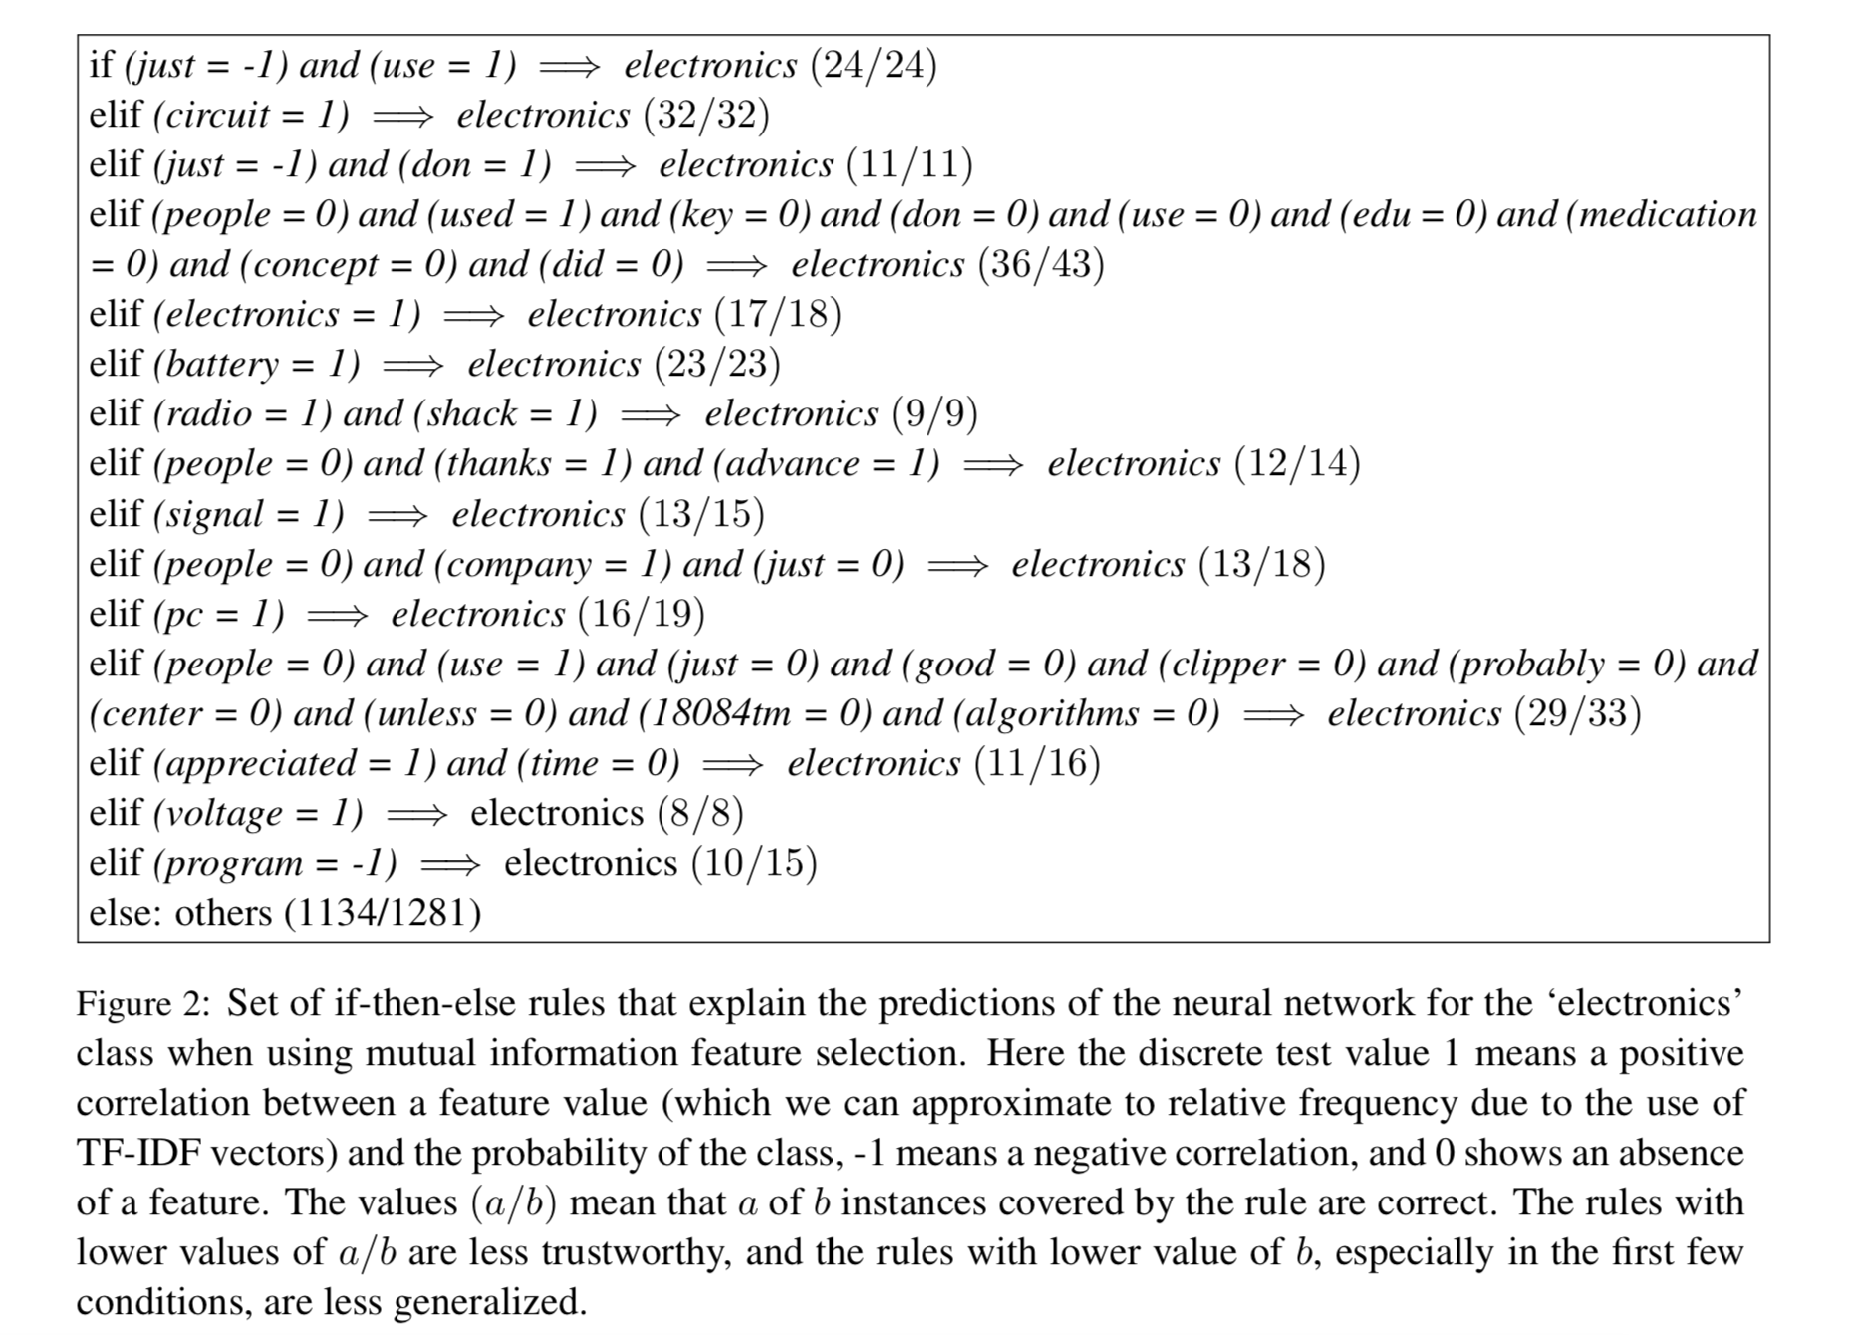
Model Explanation
Rule extraction from neural network
Showing rule set for classifying electronics out of 4 class (Space’, ‘Medicine’, ‘Electronics’ and ‘Cryptography’ from the 20-newsgroups dataset for text classification).
If n features then at-least 2^{n} possible rules. !!
Not scalable for large models.
Is it easy to understand the rules?
[Sushil 2018]

Slide 35
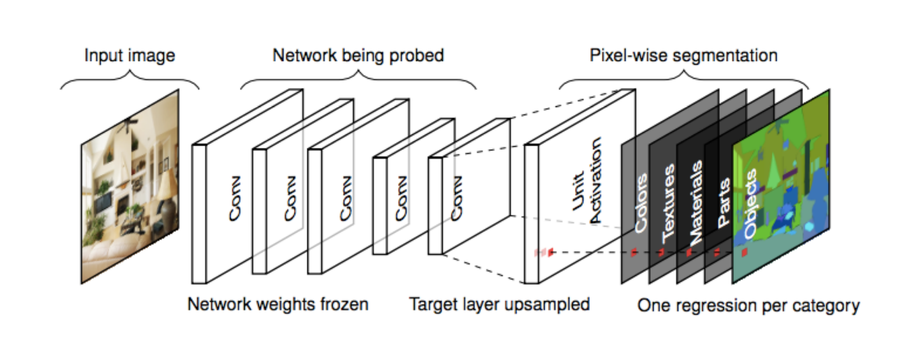
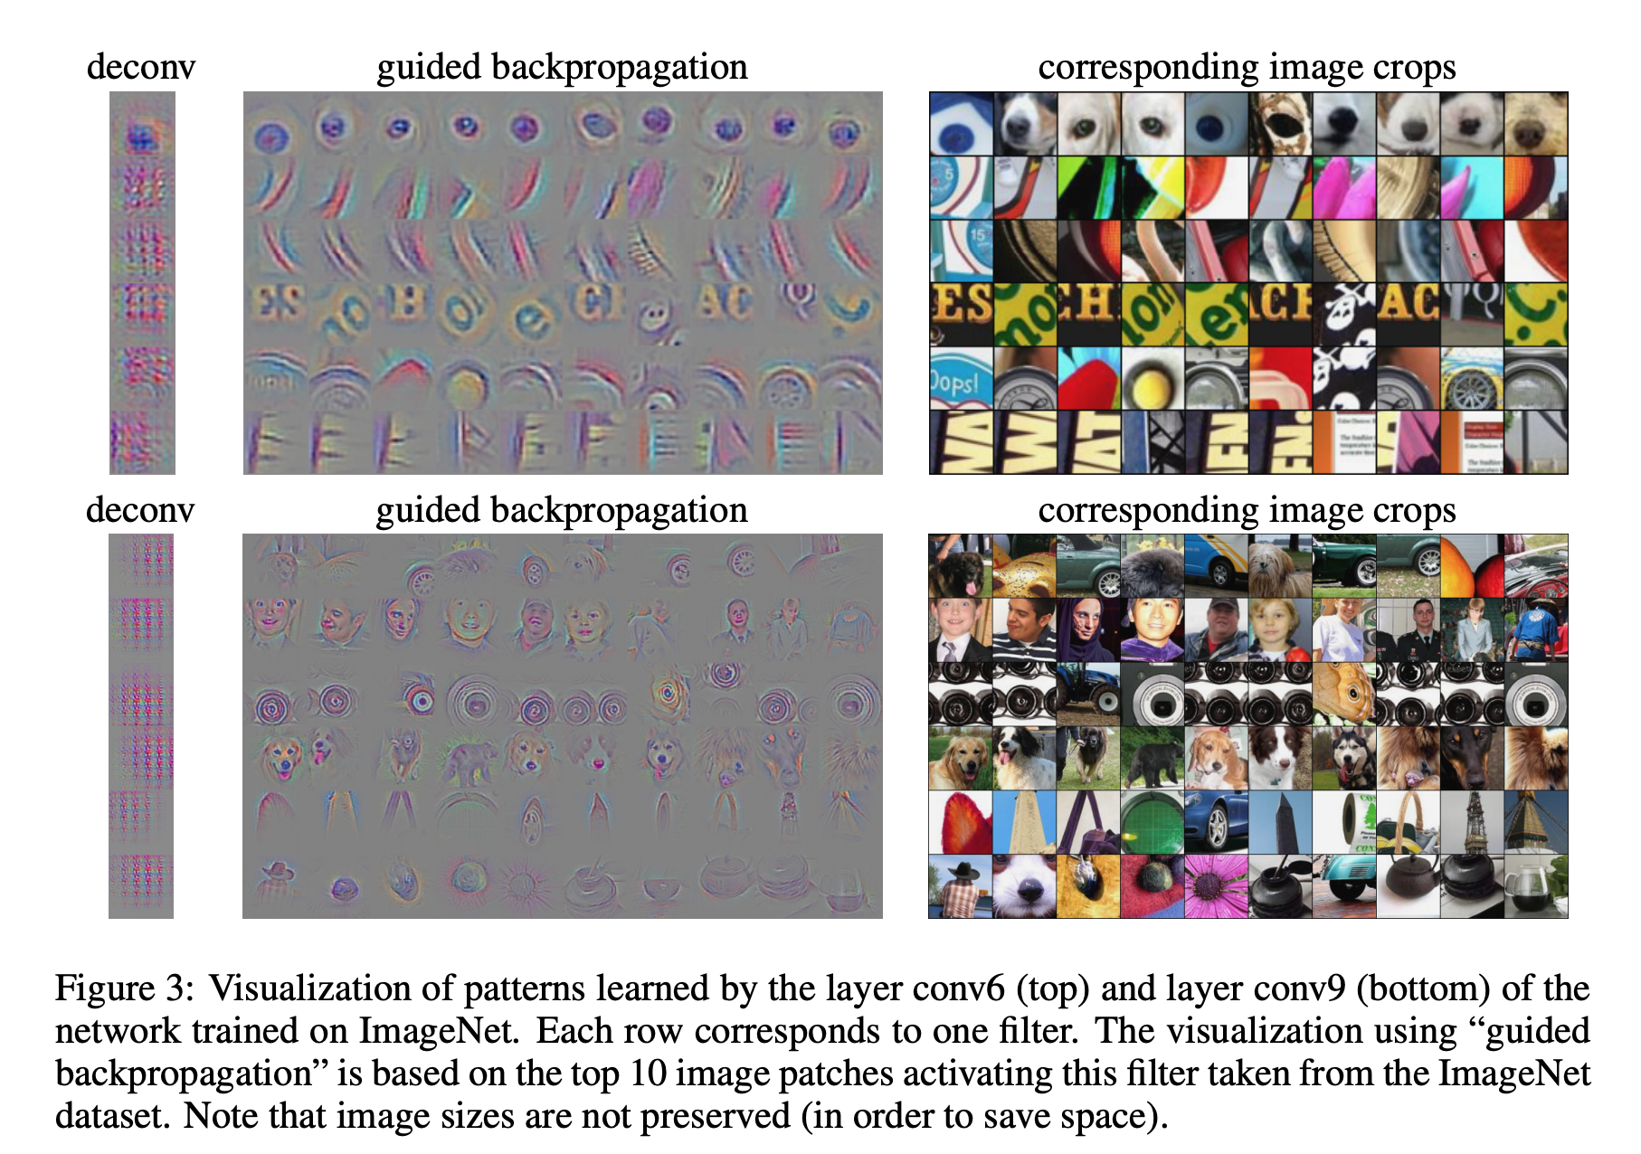
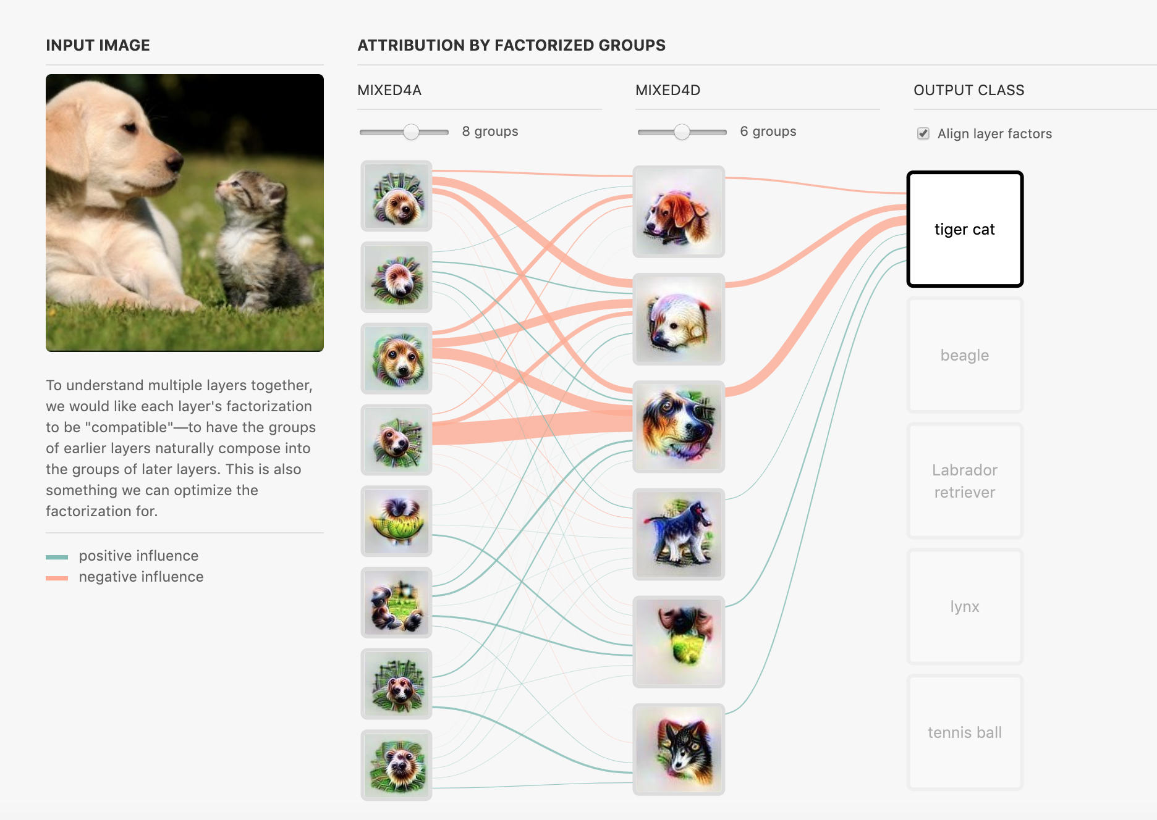
Model Explanation
Looking the hidden layers
Visualize the hidden conv layers
This approach mostly suited for image classification.
We get some sense of what is going inside.
Some times the pictures we get from hidden layers are not understandable.
https://distill.pub/2019/activation-atlas/
[Springenberg, 2015]

Slide 36
Model Explanation
Limitation
Ruleset are hard to understand for big models.
Visualization only helps for image classification
Parts of the pictures don’t always make understandable object.
Human understands hierarchical relation easily but, no relationship between the objects are maintained.

Slide 37
XAI
Explanation
Before Building Model
Explanation
During Building Model
Explanation
After Building Model
Not satisfying us, let’s go to next step
Not satisfying us, let’s go to next step
Somewhat satisfying but not fully.

Slide 38
XAI
After failing to understand the explanation using XAI techniques what can we do?
More Research using statistics, deep learning, linear algebra?
Can we use semantic web techniques?

Slide 39
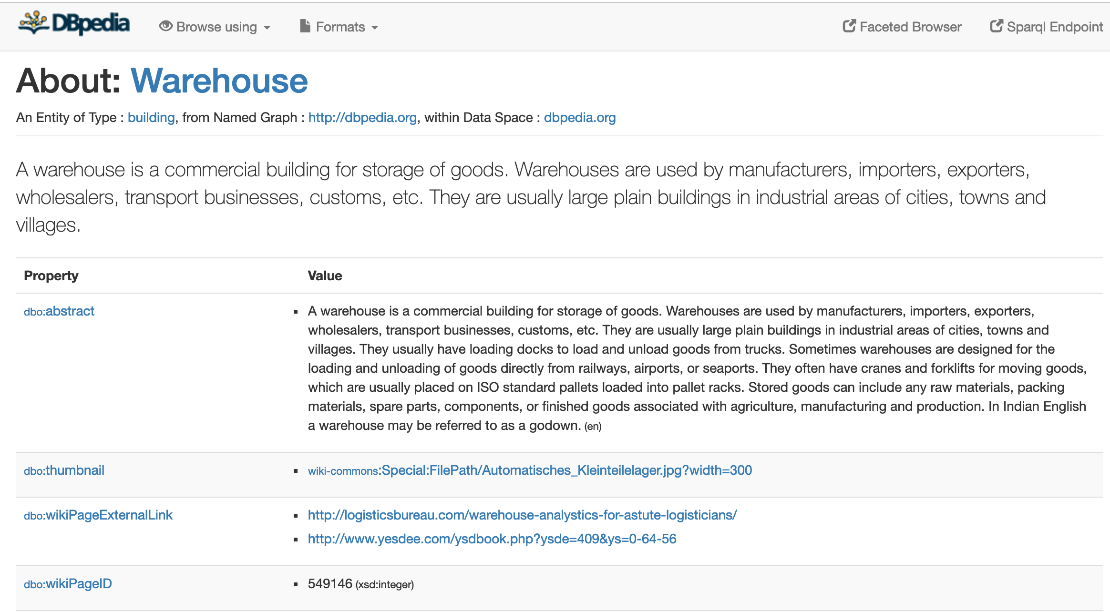
Using Semantic Web Techniques
Semantic web has millions of structured triples.
And those triples are related to each other.
Using those related triples may enhance our understandability on what’s going inside.

Slide 40
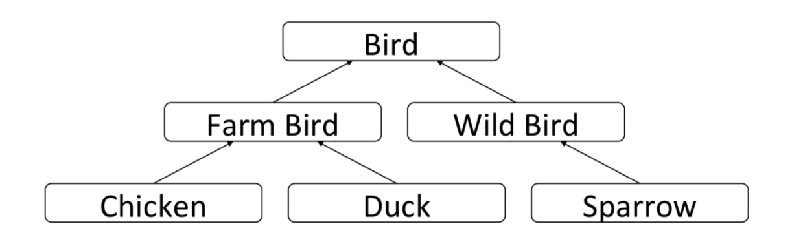
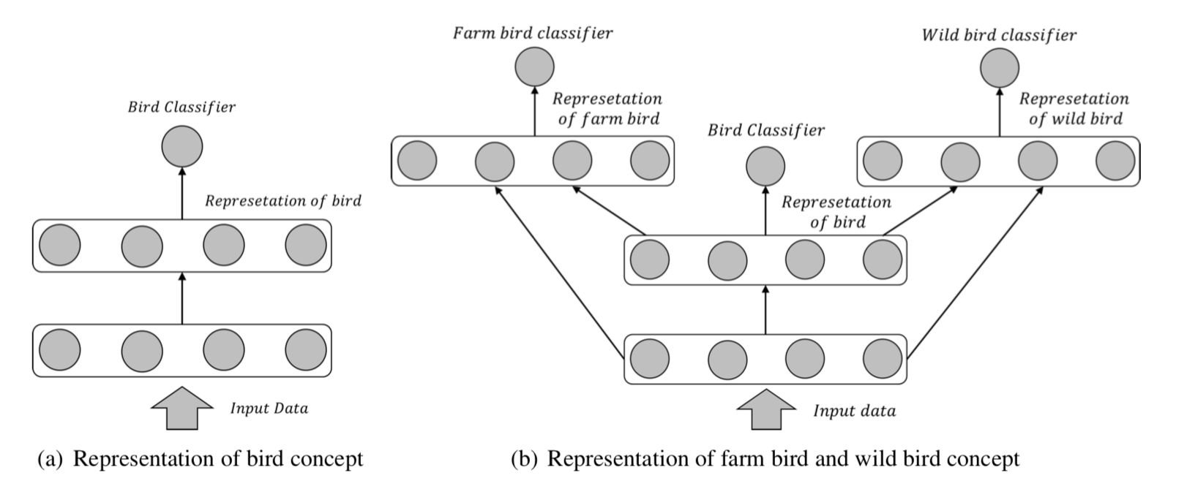
Using Semantics
Set the goal of classification as hierarchical classification.
Easily understandable by human.
But the problem is optimization gets even harder.
[Wang 2015]

Slide 41
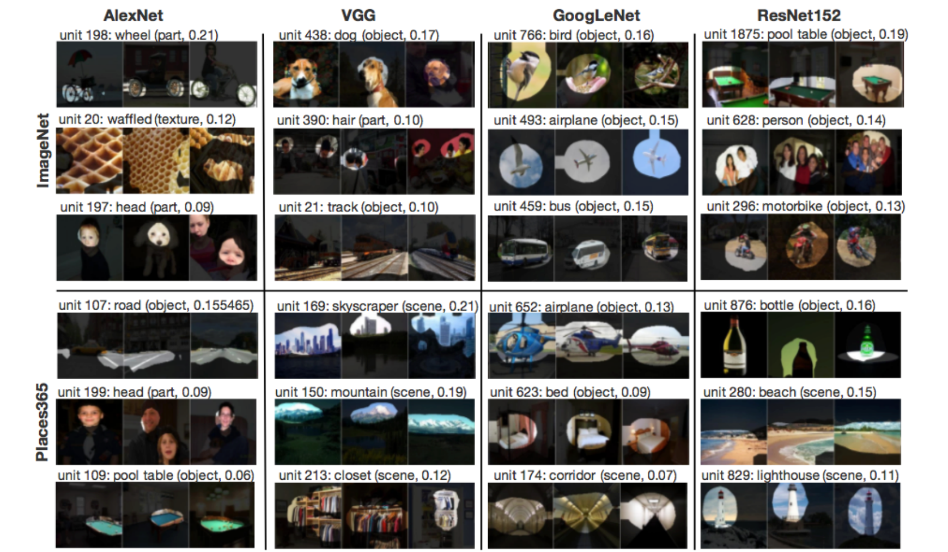
Using Semantics
[Zhou 2018] is showing hidden layers objects and corresponding labels.
Give better intuition of what is going on inside, but it requires large semantic annotations of the objects.
Currently one object is not related with other objects.
Need collaboration between semantic web community and deep learning community.
[Zhou 2018]

Slide 42
XAI with Semantics
Explanation
Not satisfying us, let’s go to next step
Before Building Model
Explanation
Optimization gets more complicated
Using semantics
During Building Model
Explanation
Enhances explanation
Using semantics
After Building Model

Slide 43
Original AI Model
AI Model
Warehouse

Slide 44

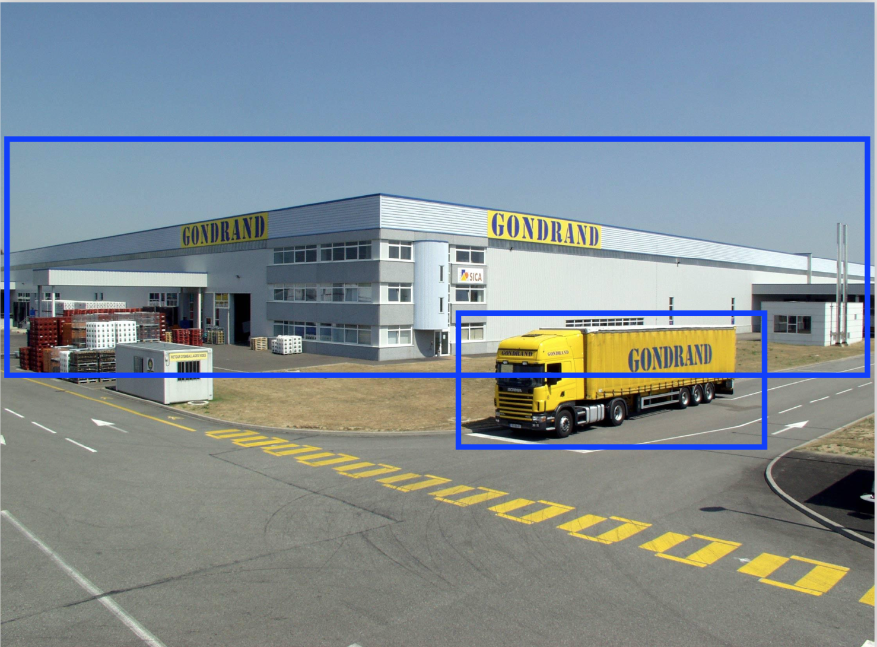
AI Model with some explanation
Warehouse
AI Model with some explanation

Slide 45
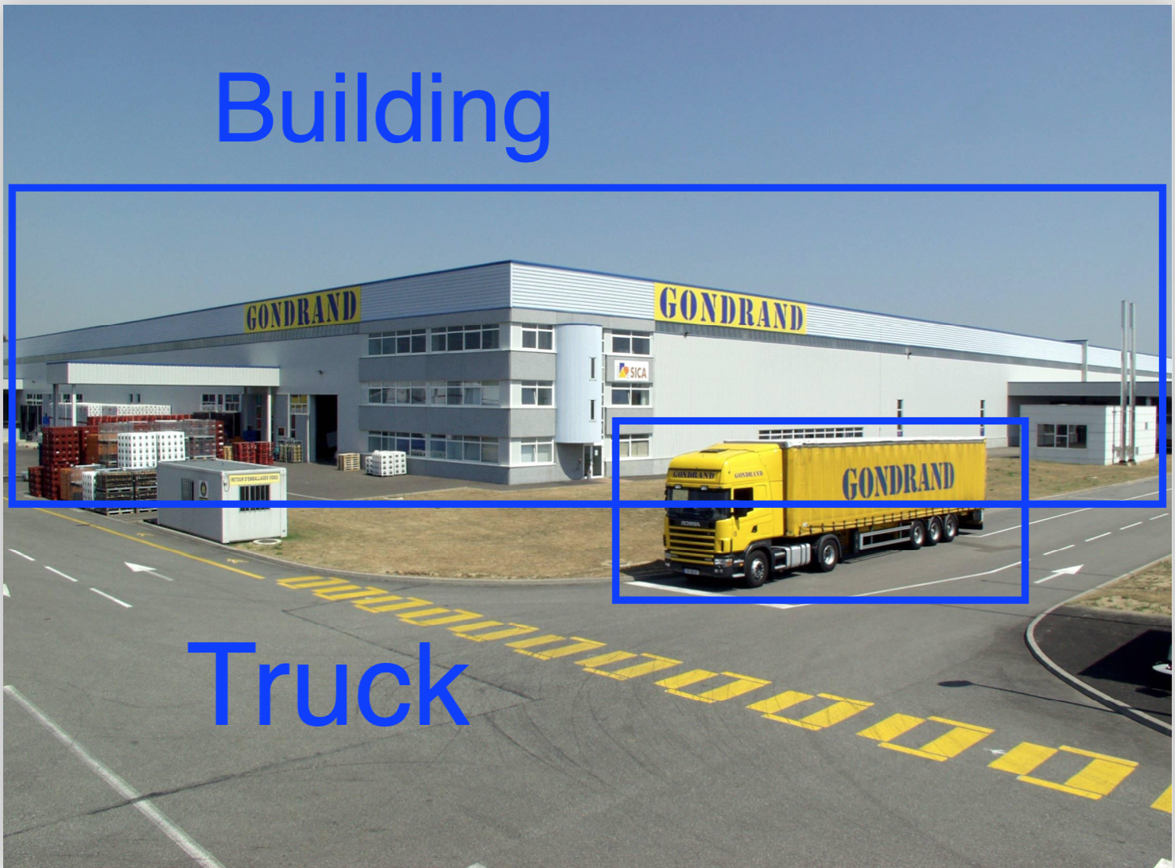




AI Model using semantics
Enhanced explanation using semantic web technology
Warehoue
This image contains building, truck,
door, window which are
usually found in warehouse.
So it seems this picture is a
Warehouse picture.¹
External Knowledge
Base
Symbolic Learning System
¹Derek, 2018

Slide 46
References
[David Gunning 2017] Mr. David Gunning, 2017, https://www.darpa.mil/program/explainable-artificial-intelligence
[Lipton 2016] Lipton, Zachary C. "The mythos of model interpretability. Int. Conf." Machine Learning: Workshop on Human Interpretability in Machine Learning. 2016.
[Rudin 2018] Rudin, Cynthia. "Please Stop Explaining Black Box Models for High Stakes Decisions." arXiv preprint arXiv:1811.10154 (2018)
[Ilaria 2015] Tiddi, Ilaria; d'Aquin, Mathieu and Motta, Enrico (2015). "An Ontology Design Pattern to Define Explanations". In: Proceedings of the 8th International Conference on Knowledge Capture, ACM, article no. 3.
[Riccardo 2018] Guidotti, R., Monreale, A., Ruggieri, S., Turini, F., Giannotti, F., & Pedreschi, D. (2018). "A survey of methods for explaining black box models". ACM Computing Surveys (CSUR), 51(5), 93.
[Ribeiro 2016] Marco Tulio Ribeiro, Sameer Singh, and Carlos Guestrin. 2016. "Why should I trust you?: Explaining the predictions of any classifier". KDD.
[Ramprasaath 2016] Ramprasaath R. Selvaraju, Michael Cogswell, Abhishek Das, Ramakrishna Vedantam, Devi Parikh, Dhruv Batra "Grad-CAM: Visual Explanations from Deep Networks via Gradient-based Localization", https://arxiv.org/abs/1610.02391
[Zhou 2015] Bolei Zhou, Aditya Khosla, Agata Lapedriza, Aude Oliva, Antonio Torralba, "Learning Deep Features for Discriminative Localization", https://arxiv.org/abs/1512.04150
[Shrikumar 2017] Avanti Shrikumar, Peyton Greenside, Anshul Kundaje, "Learning Important Features Through Propagating Activation Differences", https://arxiv.org/abs/1704.02685

Slide 47
References
[Hendricks 16] Lisa Anne Hendricks, Zeynep Akata, Marcus Rohrbach, Jeff Donahue, Bernt Schiele, Trevor Darrell, "Generating Visual Explanations", https://arxiv.org/abs/1603.08507
[Chakraborty 2018] Anirban Chakraborty, Manaar Alam, Vishal Dey, Anupam Chattopadhyay, Debdeep Mukhopadhyay "Adversarial Attacks and Defences: A Survey", https://arxiv.org/abs/1810.00069
[Thrun, 1996] Sebastian Thrun, "Extracting Rules from Artificial Neural Networks with Distributed Representations", NIPS 1996
[Hailesilassie, 2016] Tameru Hailesilassie, "Rule Extraction Algorithm for Deep Neural Networks: A Review", (IJCSIS) International Journal of Computer Science and Information Security, Vol. 14, No. 7, July 2016
[Craven, 1996] Mark W. Craven, "Extracting Comprehensible Models from Trained Neural Networks". PhD thesis, Department of Computer Sciences, University of Wisconsin-Madison, 1996
[Doshi-Velez, 2017] Finale Doshi-Velez, Been Kim, "Towards A Rigorous Science of Interpretable Machine Learning", https://arxiv.org/abs/1702.08608
[Springenberg, 2015] Jost Tobias Springenberg, Alexey Dosovitskiy, Thomas Brox, Martin Riedmiller, "Striving for Simplicity: The All Convolutional Net" https://arxiv.org/abs/1412.6806
[Zhou 2018] Bolei Zhou, David Bau, Aude Oliva, Antonio Torralba, "Interpreting Deep Visual Representations via Network Dissection" https://arxiv.org/abs/1711.05611
[Sushil 2018] Madhumita Sushil, Simon Suster and Walter Daelemans, "Rule induction for global explanation of trained models", https://arxiv.org/abs/1808.09744

Slide 48
References
[Wang 2015] Hao Wang, "Semantic Deep Learning", https://pdfs.semanticscholar.org/988d/1295ec32ce41d06e7cf928f14a3ee079a11e.pdf
[Previti 2009] Christopher Previti, Oscar Harari ,Igor Zwir and Coral del Val, "Profile analysis and prediction of tissue-specific CpG islandmethylation classes", https://bmcbioinformatics.biomedcentral.com/articles/10.1186/1471-2105-10-116
[Doran 2018] Derek Doran, "Okay but Really... What is Explainable AI? Notions and Conceptualizations of the Field”, http://ontologforum.org/index.php/ConferenceCall_2018_11_28

Slide 49
Questions
Questions?
Other ideas how explanation can be enhanced?
Next steps to go from here?

Slide 50
Thank you
Thank you!

